Slide 1
FRUIT Classification

Slide 2
AGENDA
The purpose of this model is to predict whether the given image is Fruit or Not.
In this project TensorFlow and Keras is used to build a object detection model based on deep learning.

Slide 3
Data Description
The dataset taken form the Kaggle which contains 131 fruits images 67692
Link : https://www.kaggle.com/datasets/moltean/fruits

Slide 4
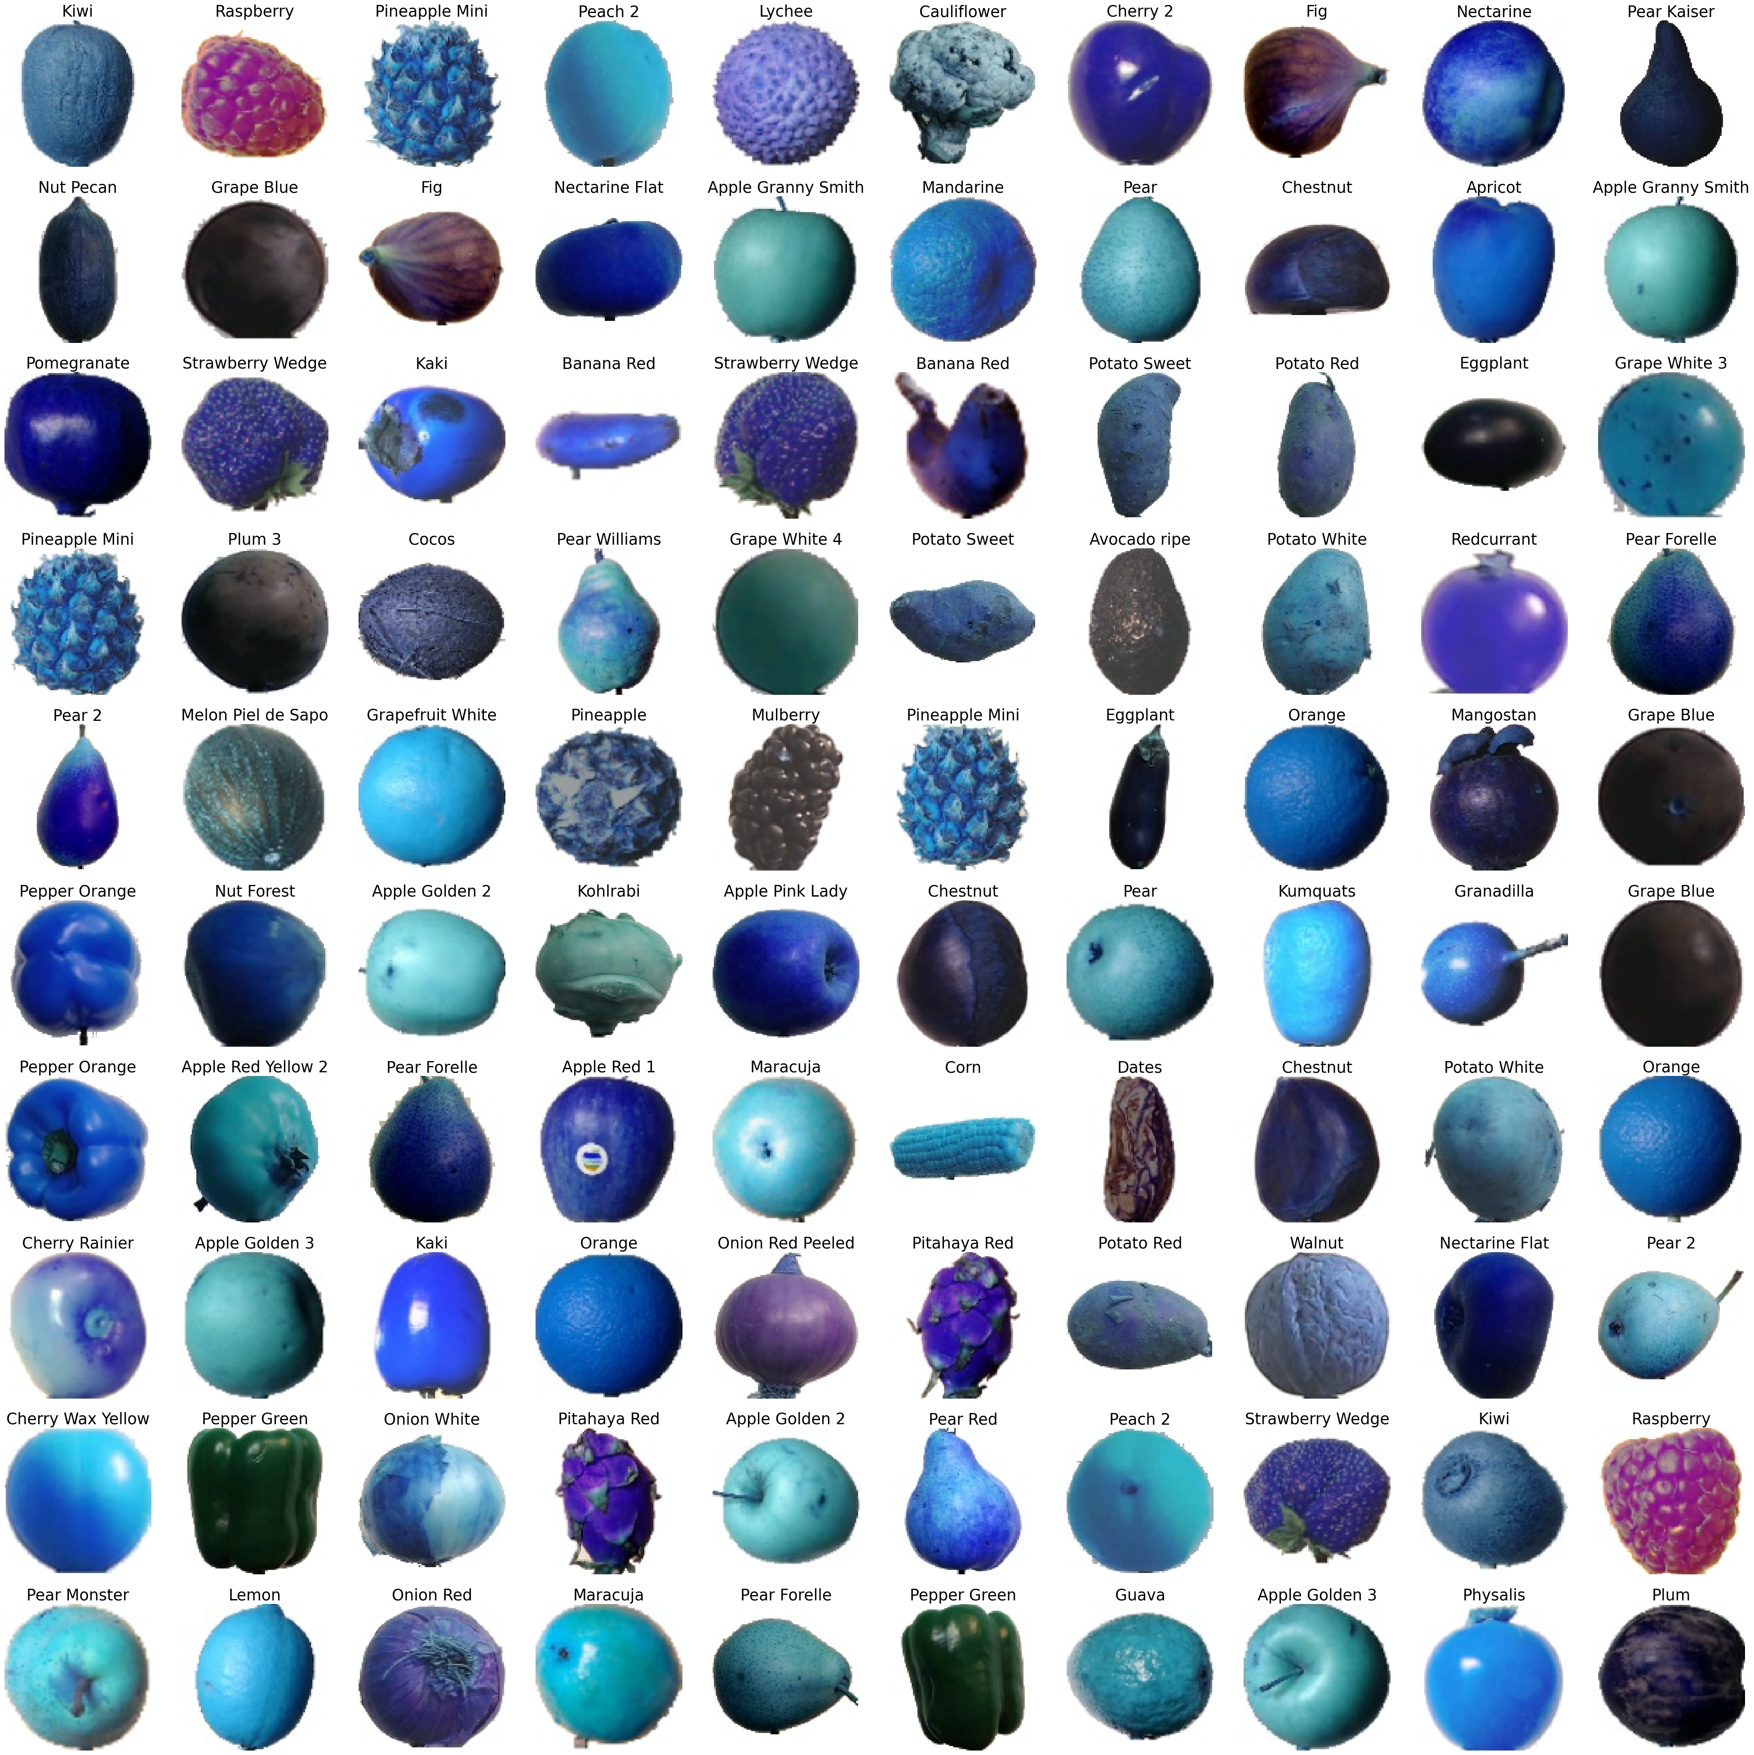
SAMPLE DATA

Slide 5
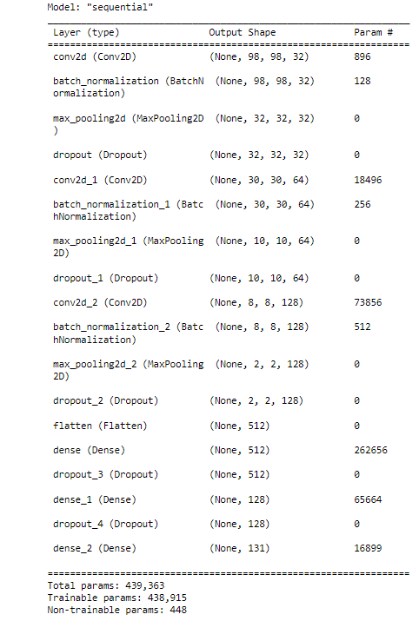
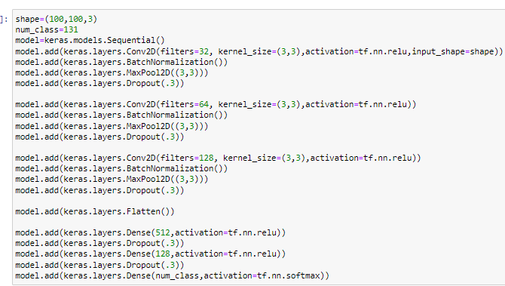
COMPILING THE MODEL

Slide 6
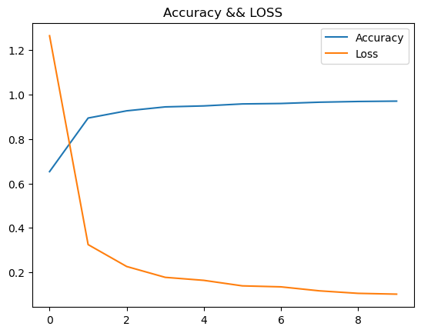
COMPARING ACCURACY

Slide 7
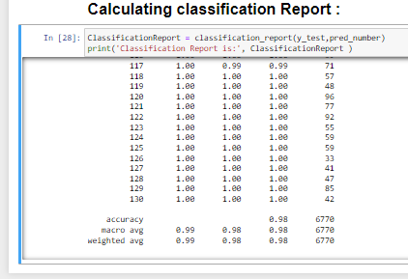
FINAL OUTPUT Result

